Slide 1
Making this resource work for you
Prior to teaching this lesson, please refer to the ‘Unit Overview and Planning Document’.
Further guidance on planning Science Mastery lessons can be found in the detailed planning guidance document.
Refer to the ‘notes’ section on each slide for useful information, including suggested expositions, pedagogical content knowledge, suggested questions, answers and more. Consider using presenter mode so you can see this guidance throughout the lesson.
The introduction slides can be adapted to suit your teaching style and the needs of your class.
Before the lesson, adapt the fix-it slide to address any misconceptions identified in the previous lesson’s exit ticket.
Choose from the suggested activities to suit your class. The intention is not that you complete all of these, but that you select those which ones are most appropriate for your students. It may be appropriate to further adapt activities for your students.
These lessons are designed to occupy approximately 1 hour. To adapt for a shorter or longer lesson duration we advise you to adapt the activity section accordingly.
Please consider using the final slide to send feedback about this lesson or examples of PowerPoints that you have adapted to our design team. Your feedback is used to improve Science Mastery for all of our teachers and students. We appreciate all suggestions and comments.
Thank you for reading!
The Science Mastery Team

Slide 2
Cancer
Answer the questions below.
State two uses of cell division.
Define mitosis.
Describe what happens to the genetic material before cell division takes place.
Explain what is meant by a balanced diet.
Describe how to test for the presence of protein.
Asexual reproduction in unicellular organisms, growth and repair in multicellular organisms.
Mitosis is the part of the cell cycle where DNA (chromosomes) are separated.
The genetic material must be replicated.
A diet consisting of sufficient amounts of each food group, vitamins and minerals that fulfils nutritional requirements.
Using Biuret reagent, which changes colour from blue to purple if protein is present.
Notes:
Foundation: Give an example of a unicellular organism.
Stretch: A rise in veganism and vegetarianism has some dieticians worried that people are not getting a balanced diet. Explain why.
Answers:
Foundation: Bacteria, some yeast, amoeba, some fungi
Stretch: Meat and dairy are a large source of protein/fat/vitamins/minerals so people must take care to eat enough of these groups from other sources.

Slide 3
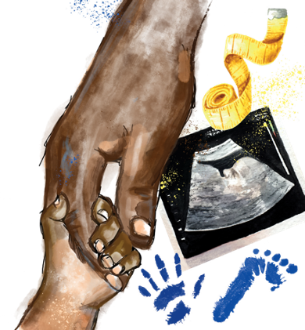
B3.1.13
12/04/2024
Cancer
B3.1.1 Prior Knowledge Review
B3.1.2 Eukaryotic and Prokaryotic Cells
B3.1.3 Aseptic Technique
B3.1.4 Growth of Bacteria
B3.1.5 Microscopes
B3.1.6 Observing Cells
B3.1.7 Diffusion
B3.1.8 Diffusion in Living Things
B3.1.9 Osmosis
B3.1.10 Osmosis Investigation
B3.1.11 Active Transport
B3.1.12 Cell Division
B3.1.13 Cancer
B3.1.14 Stem Cells
Notes:
Big Idea: Cells are alive
This lesson follows on from the previous lesson on cell division to look at happens when it goes wrong. This is a very sensitive issue as many pupils will be or have been affected by cancer and many family members will be subject to risk factors. The focus of this lesson should be on the science behind cancer and explaining what a risk factor is without creating judgement. Pupils will go on to learn about other non-communicable diseases and look at potential therapeutic treatments in a later unit.
Introducing this lesson:
There are around 367,000 cases of cancer diagnosed in the UK every year, this is a scarily high number. However, due to lots of scientific research, funding and donations cancer survival is rising and has doubled in the UK in the past 40 years (both stats from Cancer research UK https://www.cancerresearchuk.org/health-professional/cancer-statistics/survival ).

Slide 4
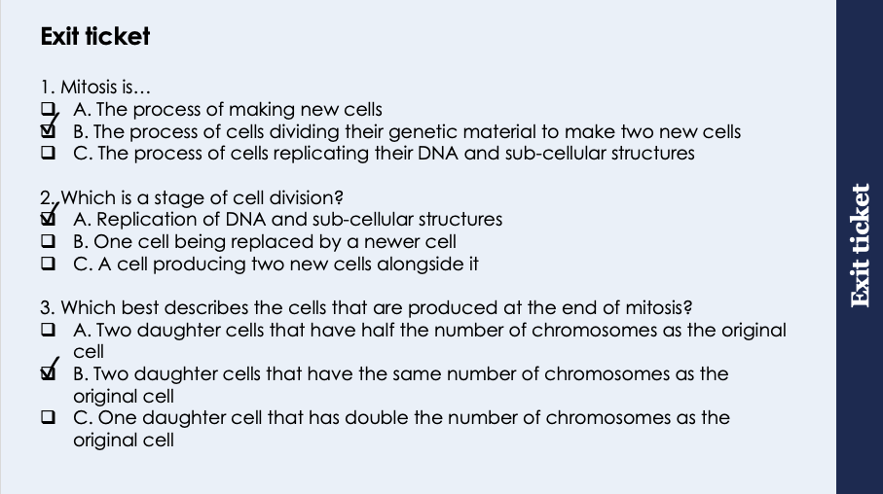
This is the fix-it portion of the lesson
The fix-it is an opportunity to respond to gaps in knowledge, especially those identified by the previous lesson’s exit ticket.
The teacher should customise this slide as needed, to facilitate
reteach, explanation, demonstration or modelling of ideas and concepts that students have not yet grasped or have misunderstood.
practise answering specific questions or of key skills.
redrafting or improving previous work.
Notes:
Purpose: to spend time on gaps identified in previous lesson’s exit ticket.
Answers:
Q1. Answer: B
If pupils have answered A they have the misconception that mitosis is the whole process of cell division. If they have answered C they have the misconception that mitosis involves the replication phase of cell division. To fix this go through the process of cell division again and highlight that mitosis is the phase where chromosomes line up and split- it is not the whole process.
Q2. Answer: A
If pupils have answered B or C they have not understood that the cell cycle is separated out into phases. To fix this go through the process of cell division again and highlight each individual phase.
Q3. Answer: B
If pupils have answered A they have not appreciated that all DNA and therefore chromosomes have been replicated before mitosis. If pupils have answered C they have not thought about the final stage after mitosis where the cell membrane divides and envelopes the separated chromosomes forming two new cells. To fix this get pupils to draw a diagram of the cell at the start of cell division, before writing the steps and drawing diagrams of the resulting identical cells.

Slide 5

Following this lesson, students will be able to:
State how cancer is caused
Describe the difference between benign and malignant tumours
Explain how certain risk factors may increase the likelihood of someone having cancer
Key Words:
cancer
risk factor
benign
malignant

Slide 6
Cancer
Tumours are a mass of cells, of which there are two different types:
Benign tumours are a mass of cells contained in one area
Malignant tumours are formed of cancer cells that invade other tissues and spread around the body forming secondary tumours
Cancer is when cell division happens uncontrollably, so cell numbers increases inappropriately
Notes:
Purpose: introducing new knowledge
Type of exposition: Explanation
Suggested script:
The cell cycle is strictly controlled. At different stages there are checkpoints at which the body ‘checks’ that nothing has gone wrong with the cell before it divides. Checkpoints also regulate the speed of cell division. When something goes wrong with the cell cycle there is potential for a cancer to develop.
When there is a sudden rapid increase in the number of cells in a particular location in the body, it creates a mass of cells known as a tumour. Not all tumours are cancerous, benign tumours are those that do not have the potential to spread to other parts of the body and so are contained in one particular area (top picture).
When we refer to a tumour being cancerous, we mean it is malignant. A malignant tumour is one that can spread (metastasise) to and invade other tissues/organs of the body and form secondary tumours in other locations.
Note: malignant means that it has the potential to spread – not necessarily that it has already spread. Malignant tumours spread (metastasise) when cells from the tumour enter the blood stream or lymphatic system, here they can travel to the rest of the body.
You may wish to discuss the stages of cancer at this point, obviously in a very sensitive way as it will most likely have affected a number of children directly.
Overview:
stage 0 – indicates that the cancer is where it started (in situ) and hasn't spread
stage I – the cancer is small and hasn't spread anywhere else
stage II – the cancer has grown, but hasn't spread
stage III – the cancer is larger and may have spread to the surrounding tissues and/or the lymph nodes (part of the lymphatic system)
stage IV – the cancer has spread from where it started to at least one other body organ; also known as "secondary" or "metastatic" cancer
Watch the video linked here: https://www.youtube.com/watch?v=BmFEoCFDi-w You only need to watch until 1:26 if focusing on the cancer cells. After this point discusses various treatments of cancer and reasons behind side effects of chemo which you may or may not want to watch.
Note: a cancer that has metastasised to another organ remains as that original type of cancer. For example breast cancer that has spread to the brain is still breast cancer even though it can now be found in the brain. The cells that spread came from the original tumour.
Note: Pupils may be aware of cancers that do not present as solid tumours ie leukaemias, lymphomas or myelomas. Simply these are cancers due to genetic problems in the cells which become blood cells. This results in rapid proliferation of abnormal blood cells leading to blood cancers.
Image: https://commons.wikimedia.org/wiki/File:BENIGN_AND_MALIGNANT_TUMOUR.png

Slide 7
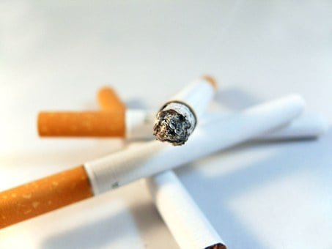
Cancer
There are various lifestyle risks for developing different types of cancer including:
Poor diet
Sedentary lifestyle (lack of exercise)
Excessive alcohol or drug consumption
Smoking
UV sunlight exposure
Exposure to various chemicals or radiation
There are also genetic risks for cancer such as the BRCA gene for breast and ovarian cancer
These risks do not mean a person will certainly get cancer but they increase the chance of it happening
Notes:
Purpose: introducing new knowledge
Type of exposition: Explanation
Suggested script:
A risk factor for any disease is something that increases the probability that someone will develop that disease. Risk factors do not mean a person will definitely get a disease they only increase the risk. There are two types of risk factor, the first is a lifestyle risk which is to do with how we live our lives and the things we do. Can you suggest a lifestyle risk for any type of cancer? Pupils likely to identify smoking for lung cancer and UV for skin cancer. All answers animated on board. Go through the ones pupils did not identify. The scientific word for a chemical that is linked to causing cancer is a carcinogen.
The second type of risk factors are genetic risks. These are mutations in the DNA of specific genes that increase the risk of the individual carrying them developing cancer. Genetic risks are located in DNA so can be passed on to offspring.
Emphasise that risk factors- even genetic risks do not guarantee that someone will get cancer. They just increase the risk compared with not having that gene.
For more able groups you may want to talk about genetic profiling for disease prevention: Scientists can now easily map individuals DNA meaning they can identify whether a person has any known gene that is a risk factor for cancers (and other diseases). People who chose to do this may use the information they get to decide whether they take preventative medical procedures. For example some people who find they are positive for the BRCA gene choose to undergo a mastectomy (removal of breasts which can then be artificially reconstructed) so that they have no chance of developing breast cancer later in life.
Image: pixabay

Slide 8
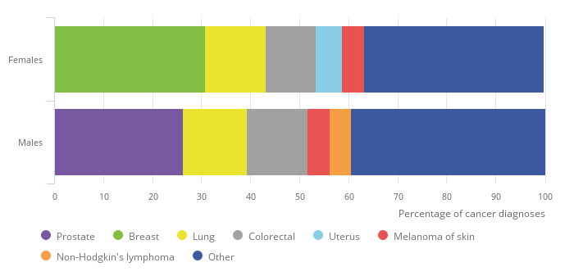
Cancer Statistics in England in 2017
Notes:
Source: Public Health England – National Cancer Registration and Analysis Service, Office for National Statistics
This is an opportunity to discuss data and give students practise interpreting graphical representation of data.
Suggested Script:
Data about different cancers can be presented in different ways. Here we have some data from Public Health England in 2017 about cancer diagnoses in males and females.
Ask pupils to answer/discuss the following questions
What is the most common cancer for females/males? Female: Breast (31-32%), Male: Prostate (26-27%)
Are males or females more likely to get lung cancer? Males are slightly more likely.
How do you think these statistics change with age? There will likely be more diagnoses with age but this may not effect the distribution of different types of cancers. Age is a risk factor for all cancers.
What lifestyle factors might influence these statistics? Smoking, alcohol/drugs, sedentary lifestyle etc (from previous slide)

Slide 9




Which statements do you agree with?
I think that malignant tumours are harmful as they are able to spread
I think that a risk factor is something that will cause you to have cancer
I think that cancer is caused when cells divide much more rapidly than usual
I think that there is an increased risk of getting cancer the older you get
Notes:
Elicit a discussion between pairs
Blue – false – it is will increase the likelihood but will not cause you to have cancer
Yellow – true
Green – true – this is uncontrollable cell division
Red – true - this is mainly due to the effects of long-term lifestyle risks taking hold
Suggested guidance:
Talk tasks can be used in a variety of ways to suit the particular needs of the students you are teaching. Through exchanging views with others, students develop their understanding of the science beyond what could be achieved individually.
Science classrooms that successfully integrate talk have the following features:
Science talk is a regular feature of lessons and is woven into classroom activities.
Students are paired or grouped strategically by the teacher to ensure productive interaction. This might take into consideration the students’ proficiency of the English language, how encouraging they might be to peers and their attainment in the topic. It’s a good idea to consider these pairings in the class seating plan.
Students are encouraged and supported to talk, but are not forced to talk.
The teacher should take on the role of a facilitator, engaging with conversations where necessary and encouraging or steering the conversation where needed.
Students are encouraged to use the language they have to express their ideas (e.g., everyday language, imperfect English, native language), but also to incorporate science specific terminology where this is more accurate or has been taught.
6. Scientifically inaccurate ideas are not dismissed by the partner or teacher; open discussion and further investigation are relied on to help students construct ideas that support them to progress in their scientific understanding.
7. Guidelines for behaviour during talk tasks are explicit and frequently reviewed. Rules for students might be:
Listen carefully to your partner
Take turns talking.
Speak one at a time, without interrupting.
Politely agree or disagree and explain why.
Politely point out if your partner has used a scientific word incorrectly, if they have explained the science incorrectly, or if there is a more accurate way to describe something.
If confused, ask questions.
Stay focused on the discussion topic.
Respond to one another.

Slide 10
Quick Quiz
Choose the correct answer for each question:
Malignant tumours are more worrying than benign tumours because…
A. They can invade other tissues and create secondary tumours
B. They are contained in one area which increases the size of the tumour
Cancer occurs when…
A. Cell division happens uncontrollably so that the number of cells decreases excessively
B. Cell division happens uncontrollably so the number of cells increases excessively
A person could reduce their risk of cancer by…
A. Exercising more, eating a healthy balanced diet and limiting alcohol intake
B. Drinking more alcohol, smoking and sunbathing every day
✓
✓
✓
Notes:
Purpose: assess understanding of new information and key prior knowledge. Get students to hold up number of fingers or thumbs up/down. Take consensus with answers and use questioning to explain why these are the answers.
Answers:
A
B
A

Slide 11
Drill
Define cancer
Define a benign tumour
Define a malignant tumour
State which type of tumour leads to cancer
Define risk factor (of cancer)
State three lifestyle risk factors for cancer
Notes:
Purpose: This is a knowledge drill. The purpose of this is to check that the critical knowledge is secure before pupils move onto independent practice.
Suggested guidance: There are a range of ways this could be done depending on time and ability range of the class:
Mini whiteboards
As full sentences in exercise books
As short answers in exercise books
In the pupil workbook
As pair talk
As cold call

Slide 12
Drill answers
Cancer is when cell division happens uncontrollably, so cell numbers increases inappropriately
Benign tumours are a mass of cells contained in one area
Malignant tumours are formed of cancer cells that invade other tissues and spread around the body forming secondary tumours
Malignant tumour
Something that can increase the likelihood of cancer developing
Poor diet, sedentary lifestyle (lack of exercise), excessive alcohol or drug consumption, smoking, UV sunlight exposure, exposure to various chemicals or radiation
Notes:
Purpose: This is a knowledge drill. The purpose of this is to check that the critical knowledge is secure before pupils move onto independent practice.
Suggested guidance: There are a range of ways this could be done depending on time and ability range of the class:
Mini whiteboards
As full sentences in exercise books
As short answers in exercise books
In the pupil workbook
As pair talk
As cold call

Slide 13
I: Analysing Patterns in Data
The graph shows the number of deaths caused by lung cancer at different ages for women and men.
What are the patterns shown in the data?
Number of deaths per 100,000 people
40-49
50-59
20-29
30-39
60-69
70-79
Notes:
Note: all of the following data should be handled sensitively as many students will have personal experience with family cancer diagnoses.
Model Answer:
As age increases, the number of deaths linked to lung cancer increases with age for both women and men. Men show a higher increase in deaths than women. For example, at age 60-69 men are almost twice as likely to die from lung cancer than women.
Purpose: The I-We-You section aims to support pupils to build skills that they most commonly need when answering questions associated with this knowledge in the assessment. This section is also used to interleave other content we expect pupils to know at this stage of their education in order that they build a big picture of the science they are learning.
For the ‘I’ activity, the teacher should model how to answer the question. They can do this by narrating their thinking process aloud, and making links to learning earlier in the lesson explicit.
For the ‘we’ activity, the teacher and students work though a similar example together, in order to prepare students to be able to answer a similar question independently.
Opportunities for the ‘you’ activity – independent practise – occur in the activity portion of the lesson once the student is secure enough to process independently.

Slide 14
We: Analysing Patterns in Data
The graph shows the survival rates after 1 year and 5 years for women diagnosed with breast cancer at different stages.
What pattern is shown in the data?
Survival rate (100%)
Notes:
Model Answer:
The later the stage of cancer, the lower the survival rate.
Survival rates are very high for stage 1 cancer.
Purpose: The I-We-You section aims to support pupils to build skills that they most commonly need when answering questions associated with this knowledge in the assessment. This section is also used to interleave other content we expect pupils to know at this stage of their education in order that they build a big picture of the science they are learning.
For the ‘I’ activity, the teacher should model how to answer the question. They can do this by narrating their thinking process aloud, and making links to learning earlier in the lesson explicit.
For the ‘we’ activity, the teacher and students work though a similar example together, in order to prepare students to be able to answer a similar question independently.
Opportunities for the ‘you’ activity – independent practise – occur in the activity portion of the lesson once the student is secure enough to process independently.

Slide 15
You: Analysing Patterns in Data
The graph shows the prevalence of different cancers that can affect both men and women.
What pattern is shown in the data?
Number of cases per 100,000 people
Notes:
Note that cancers such as prostate, ovarian, cervical and breast cancer are not included.
Model Answer:
Lung cancer is the most common of these cancers in males and females
All of these cancers are more common in men than in women
Purpose: The I-We-You section aims to support pupils to build skills that they most commonly need when answering questions associated with this knowledge in the assessment. This section is also used to interleave other content we expect pupils to know at this stage of their education in order that they build a big picture of the science they are learning.
For the ‘I’ activity, the teacher should model how to answer the question. They can do this by narrating their thinking process aloud, and making links to learning earlier in the lesson explicit.
For the ‘we’ activity, the teacher and students work though a similar example together, in order to prepare students to be able to answer a similar question independently.
Opportunities for the ‘you’ activity – independent practise – occur in the activity portion of the lesson once the student is secure enough to process independently.

Slide 16
Practice questions
Answer these questions in full sentences:
What causes cancer?
What is a benign tumour?
What is a malignant tumour?
Which type of tumour leads to cancer?
Name three risk factors for developing cancer.
Uncontrollable cell division
A mass of cells contained within one area
Formed of cancer cells that invade other tissues and spread around the body forming secondary tumours
Malignant
Poor diet, sedentary lifestyle (lack of exercise), excessive alcohol or drug consumption, smoking, UV exposure, exposure to various chemicals or radiation, genetic factors
Notes:
Stretch question: Chemotherapy is a treatment for cancer. How do you think it works? Why do people who undergo chemotherapy often lose their hair?
Answer: Targets cells undergoing rapid cell division and kills them. Hair cells rapidly divide normally so they are also targeted.

Slide 17
Cancer
Complete the Science in the News Activity
Use full sentences and keywords where necessary
Write definitions for any words in bold
Notes:
Self/peer assessment using mark scheme
Use sampling/cold calling to get best workable definitions for words in bold as a class.

Slide 18
Answer the questions below.
1. Cancer is…
A. the process of making new cells
B. when mitosis is controlled
C. uncontrollable cell division
2. What is the difference between a benign and a malignant tumour?
A. Benign tumours are isolated in one area, malignant tumours are always all over the body
B. Benign tumours are isolated in one area, malignant tumours have the potential to spread to form new tumours around the body
C. Benign tumours are all over the body, malignant tumours are isolated in one area
3. A risk factor is…
A. an unhealthy lifestyle choice that means a person will get cancer
B. a gene that is passed down and causes cancer
C. a gene or lifestyle choice that will can increase the likelihood of a person developing cancer
✓
✓
✓
Notes:
Purpose: to find out if students are able to answer key questions that check for understanding of the new information that have been covered.
Answers:
Q1. Answer: C
If pupils have answered either A or B they have not appreciated that cancer forms from an unusual or uncontrolled cell cycle and therefore uncontrolled cell division. To fix this ask pupils to define cancer and/or what a tumour is.
Q2. Answer: B
If pupils have answered A they have the misconception that a malignant tumour must have already spread, in reality it could be in one place with the ability to spread. If pupils have answered C they have mixed up the two types of tumour. T fix this ask pupils to define the different types of tumour or explain the differences between each type of tumour.
Q3. Answer: C
If pupils answered A or B they have not identified that risk factors can be either genetic or lifestyle related (not simply one). They have also not appreciated that a risk factor does not guarantee cancer but increases the risk of cancer developing. To fix this ask pupils to explain what is meant by a risk factor, both genetic and lifestyle, noting that they increase the risk but do not cause the cancer. For more able pupils it could be useful to have a discussion about the actual process of genetic mutation and the consequences.

Slide 19
Lesson B3.1.13
What was good about this lesson? | What can we do to improve this lesson?
Send us your feedback by clicking this link
or by emailing sciencemastery@arkonline.org
Thank you!

